Slide 1
Generative Adversarial Networks (GANs)
A gentle Introduction
Prof. Dr. Umberto Michelucci
umberto.michelucci@toelt.ai
umberto.Michelucci@hslu.ch

Slide 2


Painter: she would like to learn to learn to paint as Van Gogh
Critic: she would like to learn be able to tell real Van Gogh paintings from fakes apart.

Slide 3
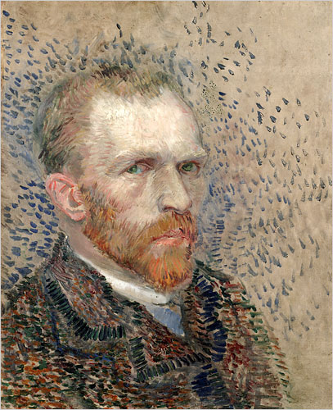
Step 1
The painter becomes slowly better
Then the critic tells the painter what was clearly wrong.
Critic: she would like to learn be able to tell real Van Gogh paintings from fakes apart.
Produce a fake portrait that is not perfect
Painter: she would like to learn to learn to paint as Van Gogh
The critic try to determine if the painting is fake or not.
FAKE

Slide 4
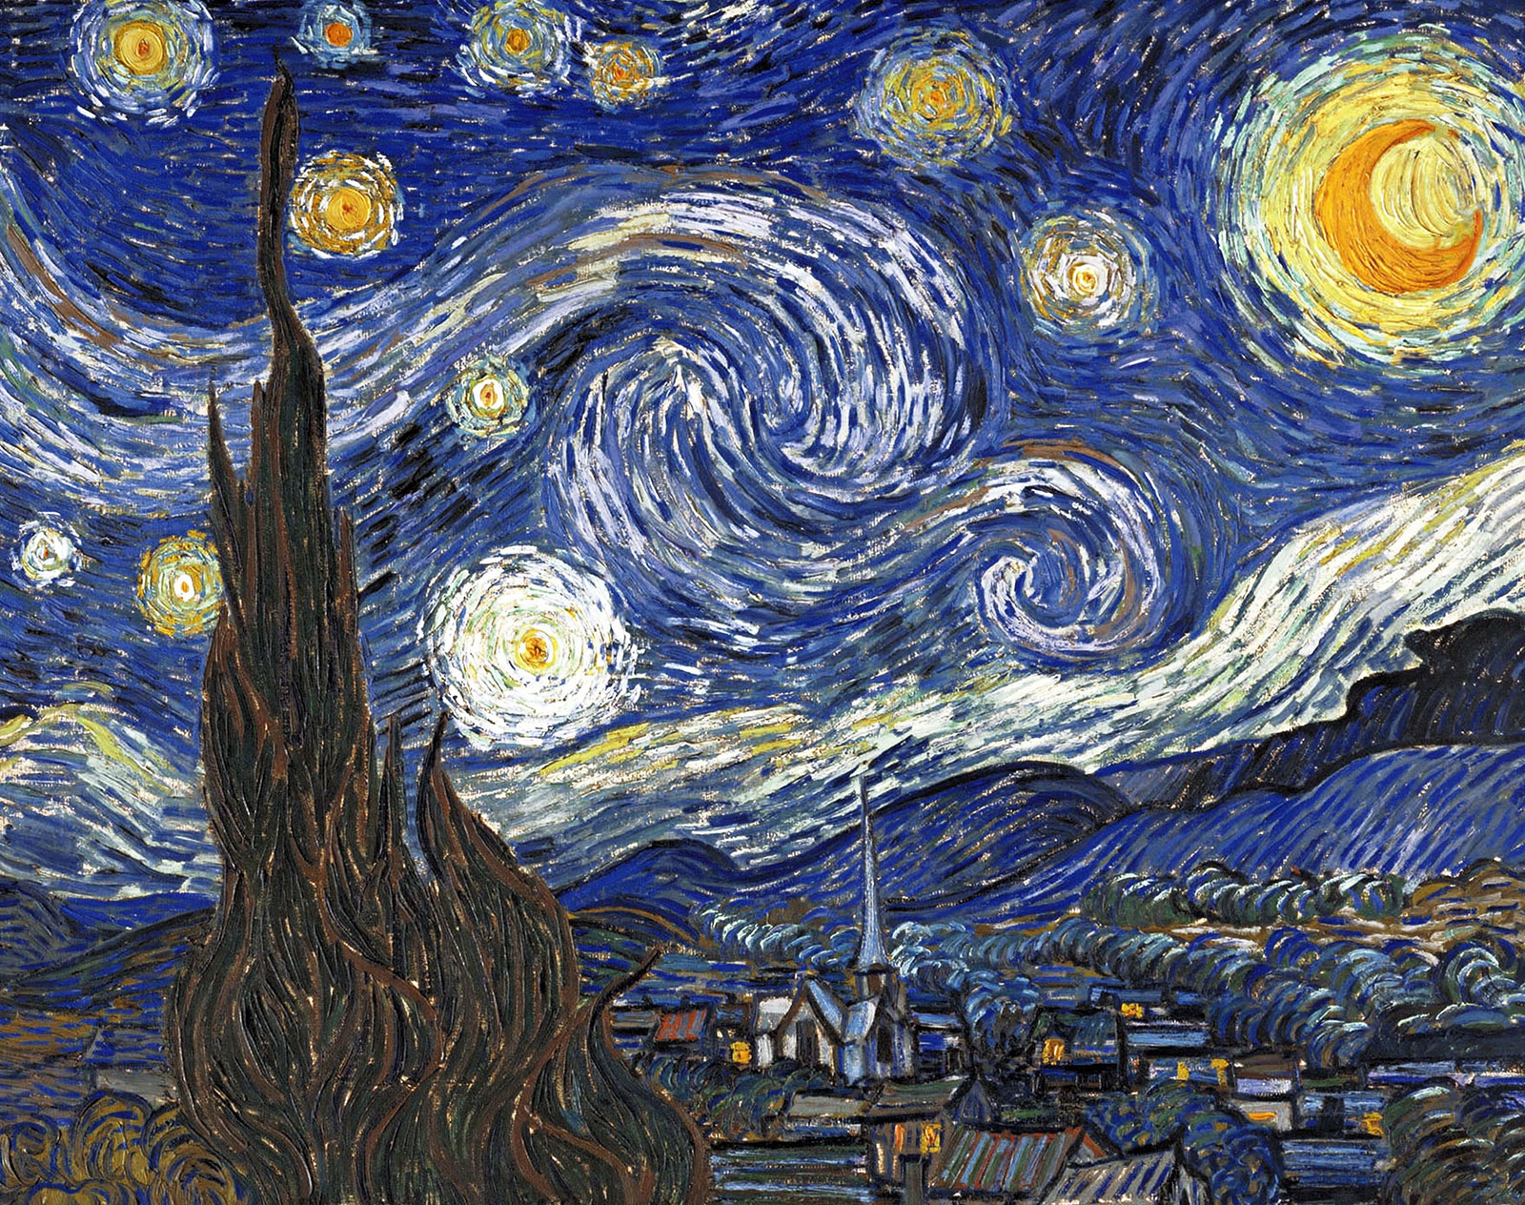
Step 2 – The critic must become better too
The critic trains with real Van Gogh paintings
The critic becomes slowly better
Critic: she would like to learn be able to tell real Van Gogh paintings from fakes apart.
TRUE
The critic trains with clearly fake Van Gogh paintings
FAKE

Slide 5
Reference – Loss Function (Cross Entropy, CE)
Predicted Class probability of painting of being real (class 1)
Class Label: 0,1
0 → Painting is fake
1 → Painting is real

Slide 6
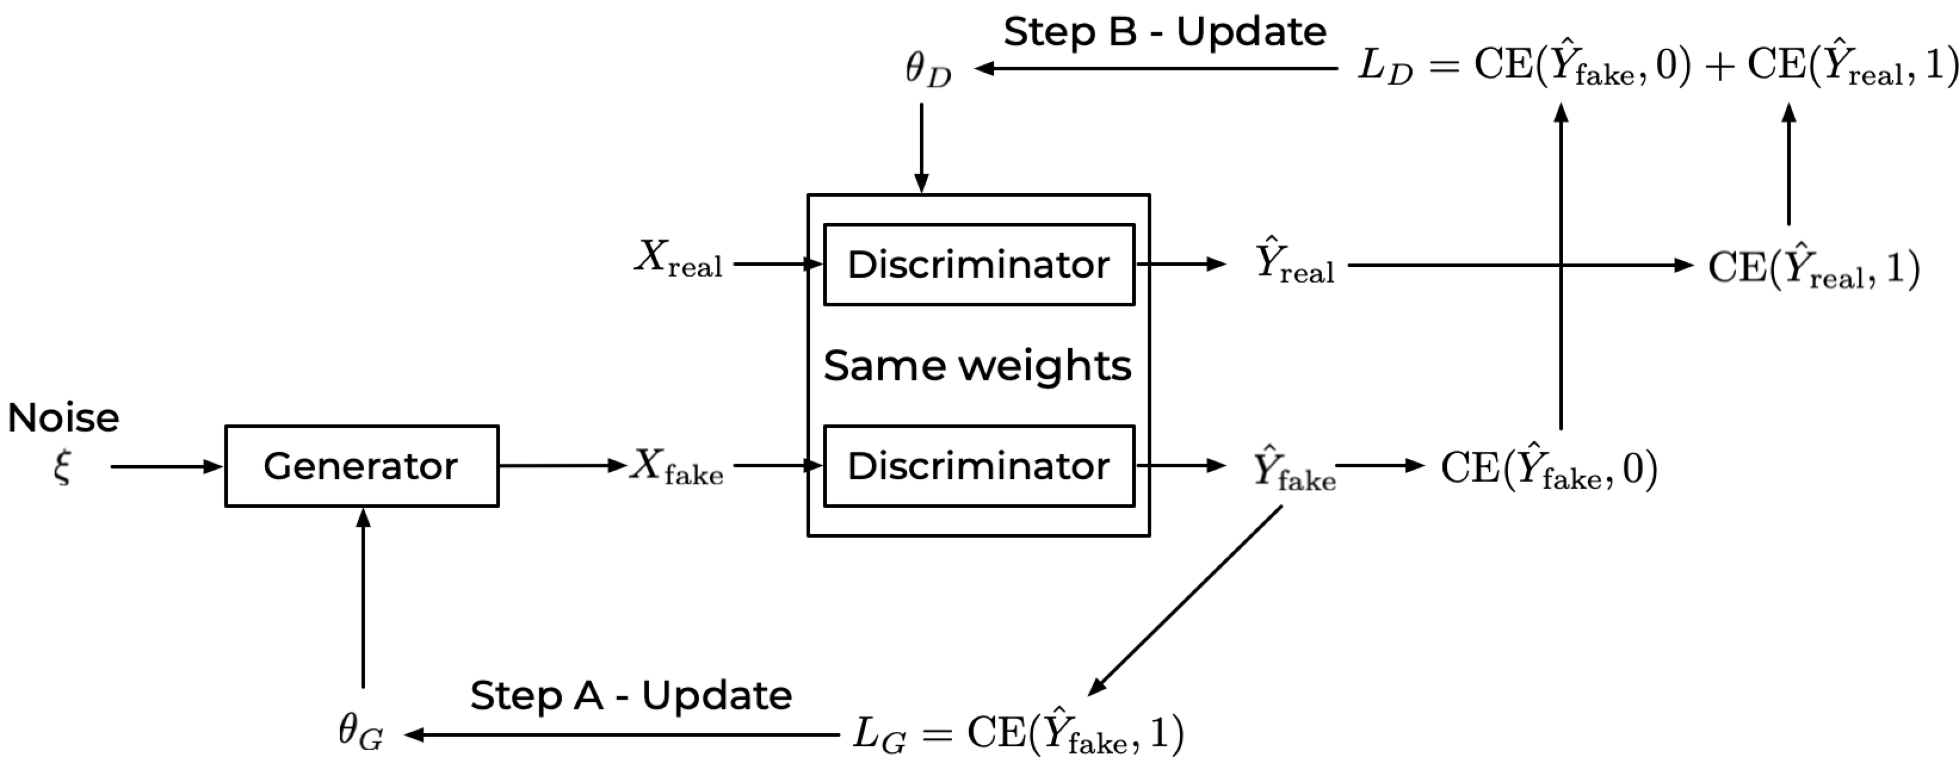
Step 2
Ideas of the painter (today I will paint a portrait,
a landscape, etc.)
Step 1

Slide 8
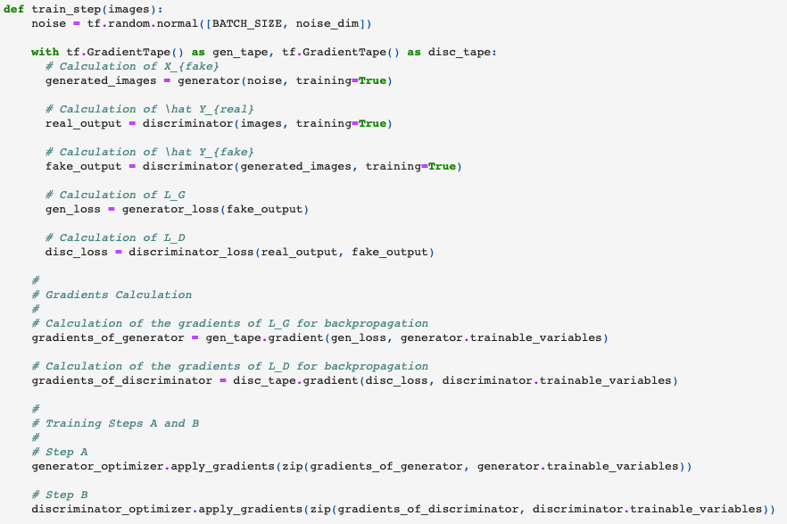




How to use Keras for GANs
The most important aspect of using Keras for GANs is the necessity of building a custom training loop (and not using compile()/fit() approach.

Slide 9
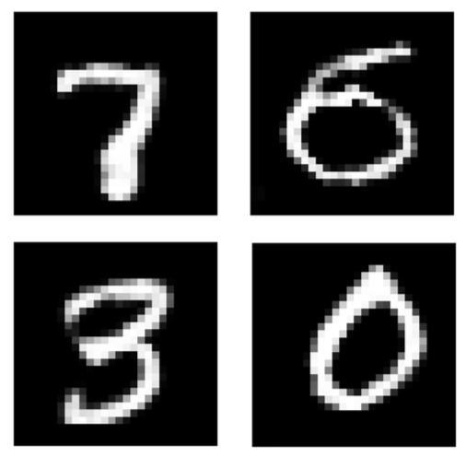
The digits were not written by a person…

Slide 10
Conditional GAN
Conditional GAN (CGAN) is a GAN variant in which both the Generator and the Discriminator are conditioned on auxiliary data such as a class label during training.
Source: https://livebook.manning.com/book/gans-in-action/chapter-8/

Slide 11
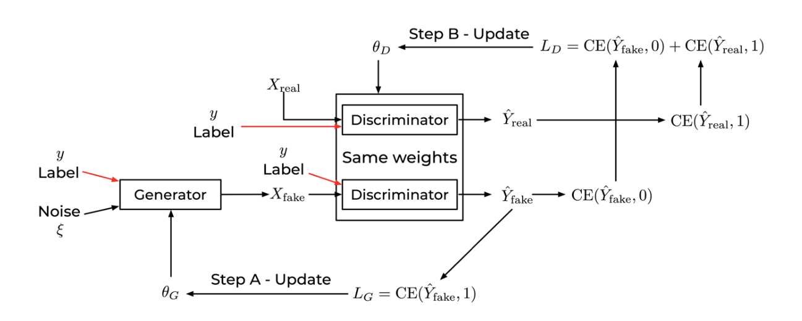
Conditional GAN

Slide 12
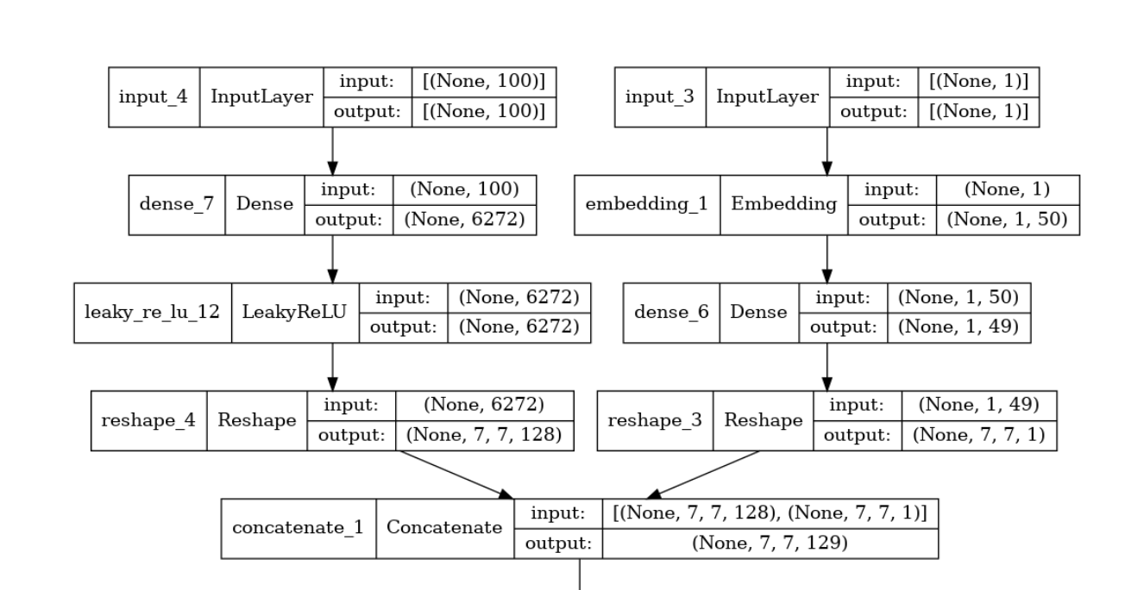
First Layers of the generator (CGAN)

Slide 13
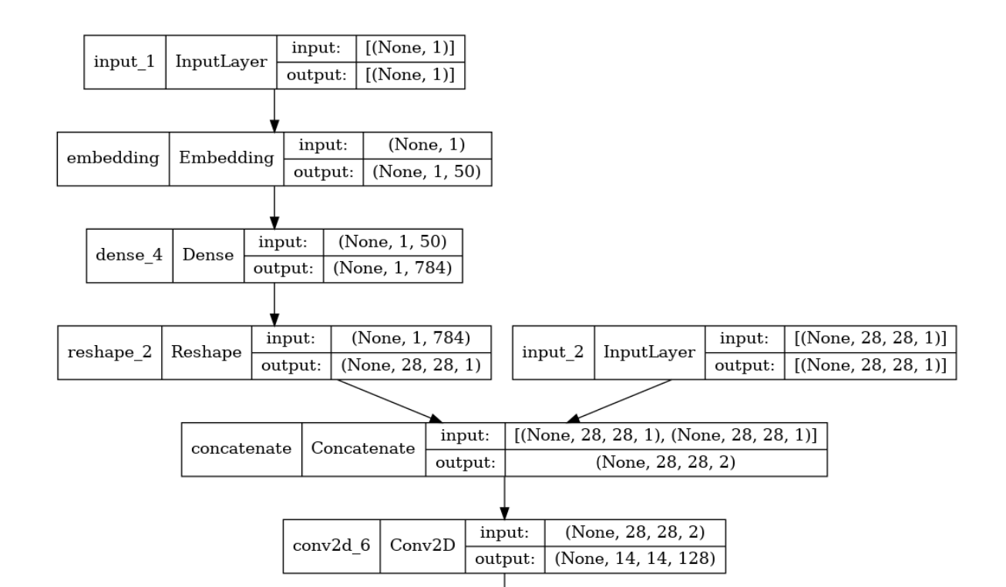
First Layers of the discriminator (CGAN)

